Slide 1
Business Presentation by Narges Shahmohammadi

Slide 2
Contents
In this presentation, we are going to get deep into the Star Hotels and elements which are effective on cancelation of booking the room
A significant number of hotel bookings are called off due to cancellations or no-shows. The typical reasons for cancellations include change of plans, scheduling conflicts, etc. This is often made easier by the option to do so free of charge or preferably at a low cost which is beneficial to hotel guests, but it is a less desirable and possibly revenue-diminishing factor for hotels to deal with. Such losses are particularly high on last-minute cancellations.

Slide 3
Business Problem Overview and Solution Approach
The increasing number of cancellations calls for a Machine Learning based solution that can help in predicting which booking is likely to be canceled.
We as data scientists must analyze the data provided to find which factors have a high influence on booking cancellations, build a predictive model that can predict which booking is going to be canceled in advance, and help in formulating profitable policies for cancellations and refunds.

Slide 4
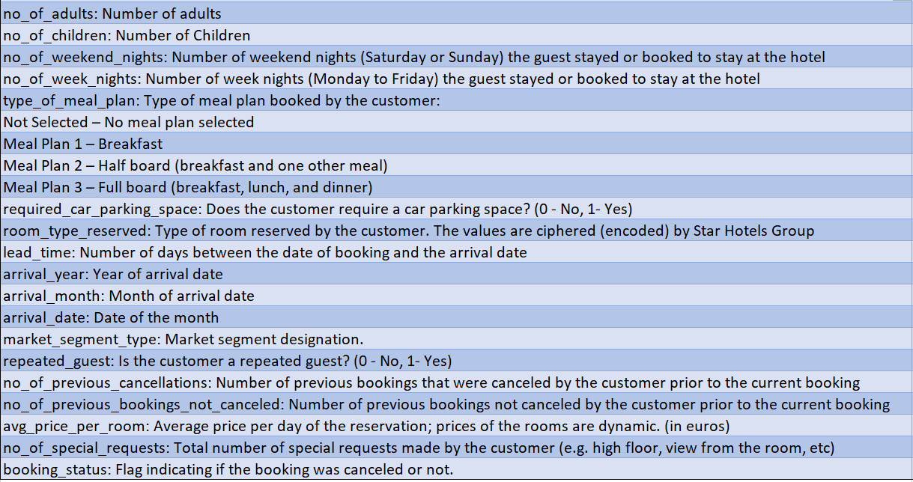
Data Overview
We have a data with 56926 rows and 18 columns
There is no missing values.
Also, we have outliers in our data
Some columns need to be dummy like type_of_meal_plan or room_type_reserved
We have 14350 duplicates value which need to delete.
13 columns are integer.
4 columns are object: (booking_status)(market_segment_type)(room_type_reserved)(type_of_meal_plan)
1 column is float: (avg_price_per_room)

Slide 5
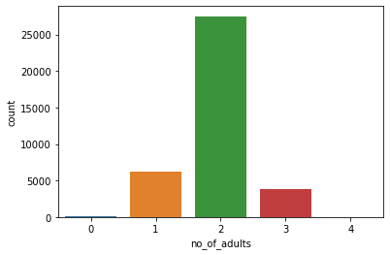
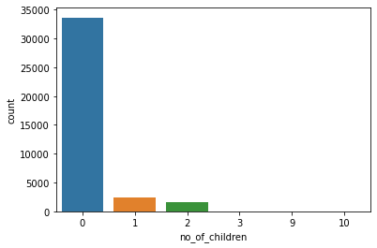
EDA
The reservation is mostly for two adults.
most of reservation is with no children

Slide 6
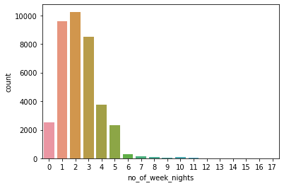
EDA
Number of week nights (Monday to Friday) the guest stayed or booked to stay at the hotel. as you can see, 2 , 1 and then 3 weeknights are on the top

Slide 7
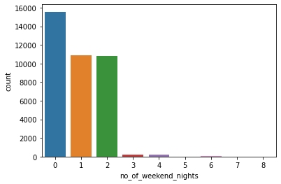
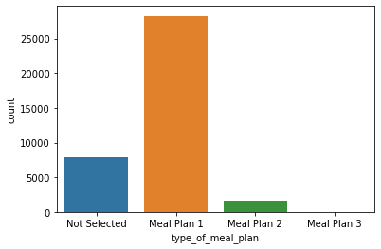
EDA
Number of weekend nights (Saturday or Sunday) the guest stayed or booked to stay at the hotel. As you see, most of the guests tend to do not book or stay at hotel at the weekends.
plot of type of meal plan booked by the customer shows us that most of them just booked for Breakfast (Meal plan 1)

Slide 8
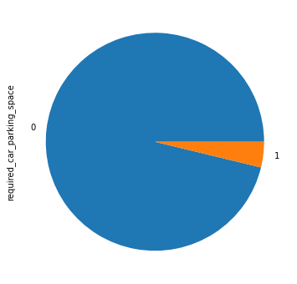
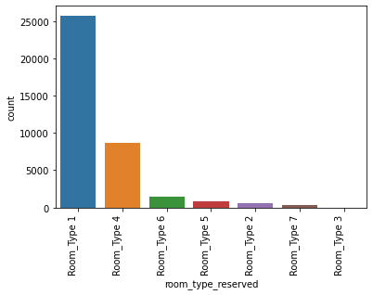
EDA
Only a few customers require car parking space
bar plot of type of room reserved by the customer shows that room type 1 is the most popular.

Slide 9
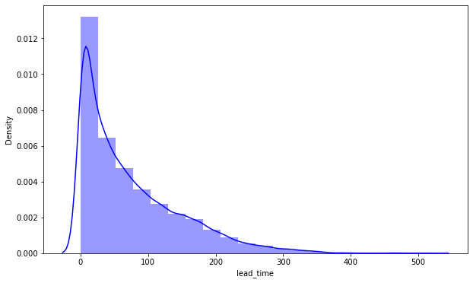
EDA
Number of days between the date of booking and the guest arrival date have a highly skewed to the right distribution. It also shows that guests tend to book hotel rooms mostly between 0 to 100 days earlier.

Slide 10
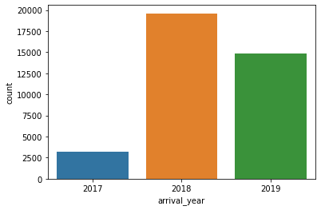
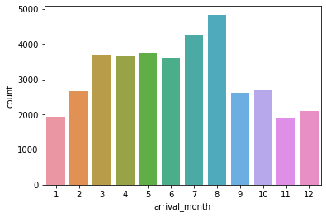
EDA
arrival date for 2018 is on the top
most of the reservations of hotel rooms are for the month of July to August. Also, first and the last two months have the lowest reservation.

Slide 11
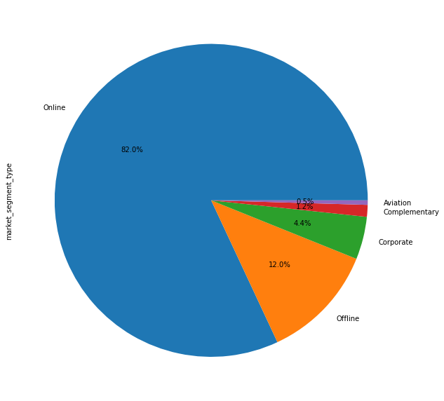
EDA
online market segment with 82% is on the top
after that offline with 12% has been located at the second place

Slide 12
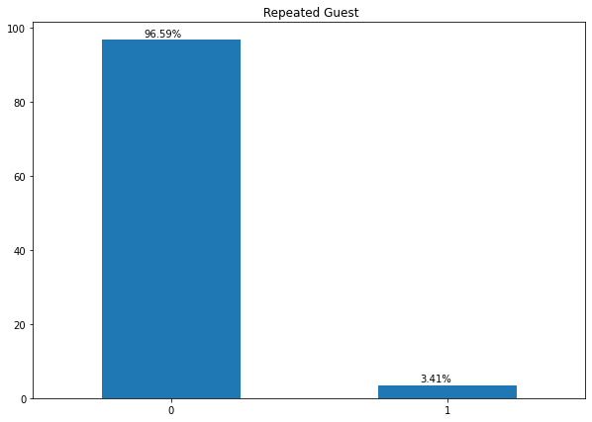
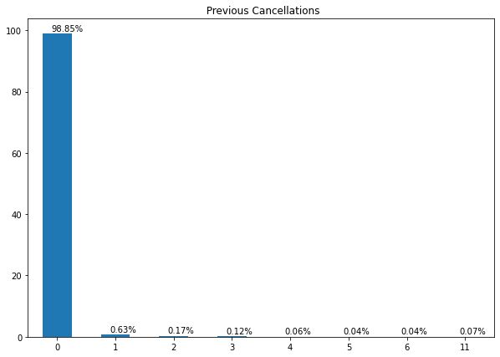
EDA
only 3.41% of the guests are repeated guest
almost all of the guests (99%) have no previous bookings that were canceled

Slide 13
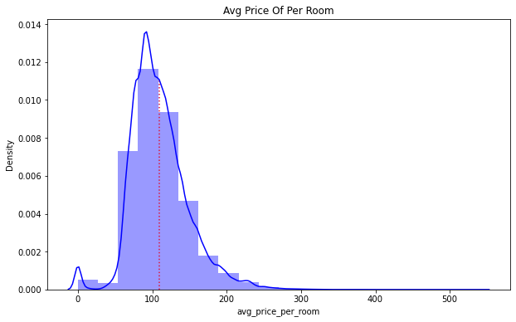
EDA
avg_price_per_room has a distribution skewed to the right. I think it is look like a normal distribution. its average is around 109 Euros.

Slide 14
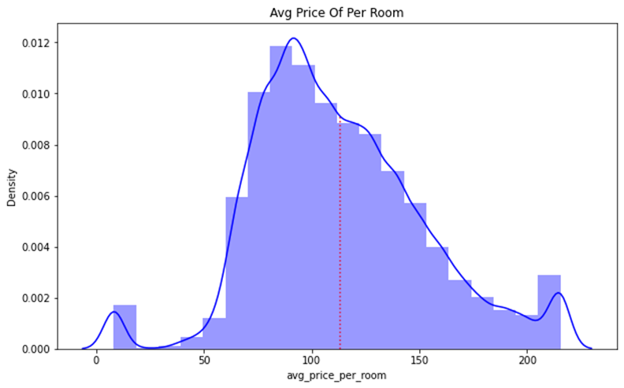
EDA
After dealing with outliers its skewness is better and still its mean is around 113 Euro.

Slide 15
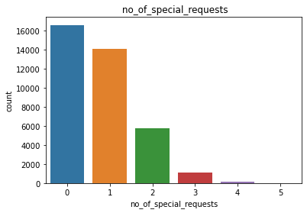
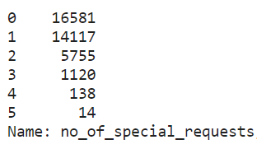
EDA
Most of the customers had no special request (16581)
After that there is 1 request with number of 14117

Slide 16
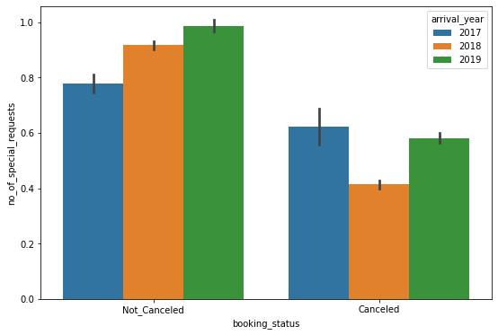
EDA
difference between booking status and the number of special requests in different years. Totally, in 2019 booking the rooms with no cancelation and a greater number of requests are higher than others. in 2017 booking the rooms and its cancelation (with high special request) are higher than others.

Slide 17
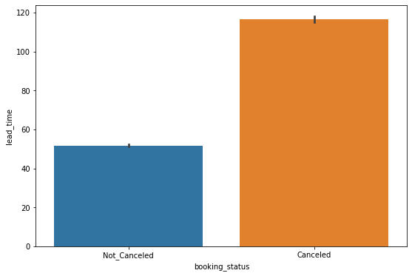
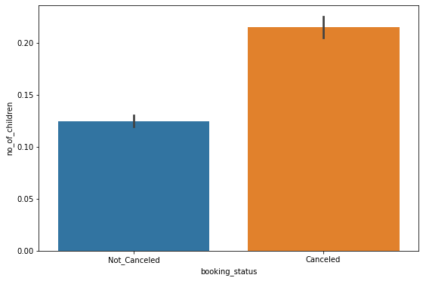
EDA
The more the lead time, the more cancelation it is.
Guests who have more children did cancel their reservations more than others.

Slide 18
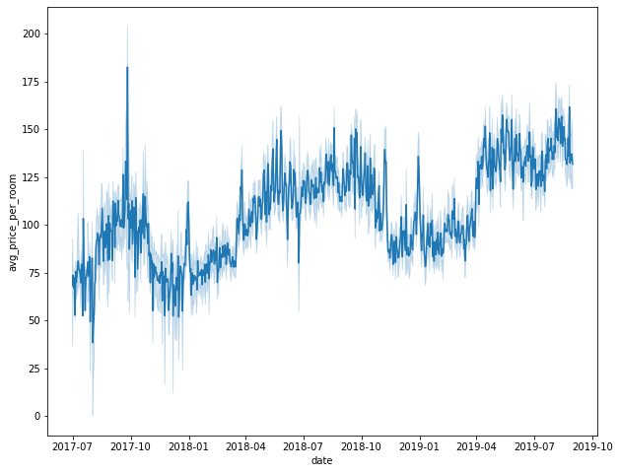
EDA
There is a increasing in price of per room between 2017 to 2019 with a mild slope

Slide 19
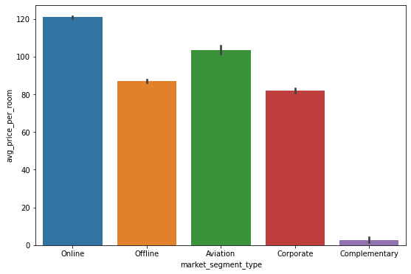
EDA
Hotel rates are dynamic and change according to demand and customer demographics. What are the differences in room prices in different market segments?
The online and complementary market segments have the highest and lowest average price, respectively.

Slide 20
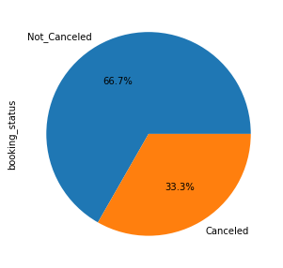
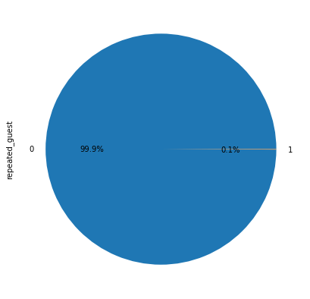
EDA
What percentage of bookings are canceled?
33.3% of guests did cancel their books.
Repeating guests are the guests who stay in the hotel often and are important to brand equity. What percentage of repeating guests cancel?
less than 1% of repeated guests cancel their reservations

Slide 21
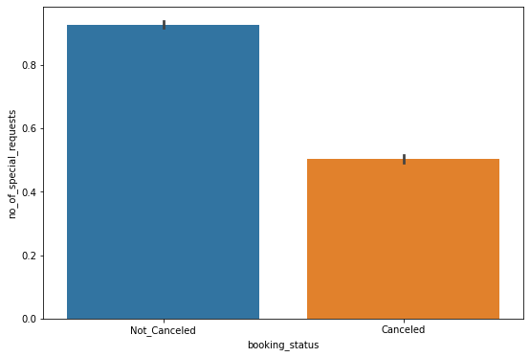
EDA
Many guests have special requirements when booking a hotel room. Do these requirements affect booking cancellation?
It seems that guests who have high special requirements tend to do not to cancel their books.

Slide 22
Model Performance Summary
Overview of the model and its parameters
Create Dummy Variables for 3 columns:[type_of_meal_plan, room_type_reserved, market_segment_type]
Convert column [booking_status] values to 1 & 0
Then I split the data:
independent variables
x = all my data but: booking_status, market_segment_type_Aviation, room_type_reserved_Room_Type 7, type_of_meal_plan_Meal Plan 2
dependent variable
y = booking_status

Slide 23
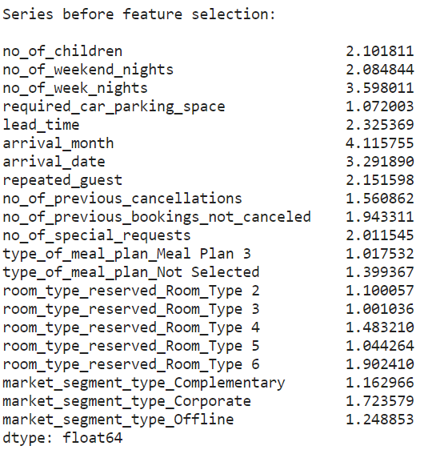
Model Performance Summary
In order to make statistical inferences from a logistic regression model, it was important to ensure that there is no multicollinearity present in the data.
I checked its multicollinearity and figured out that some columns have high multicollinearity like [some other columns exhibit high multicollinearity] and so on. I removed them one by one to see which variable has a significant impact on the model's performance. The final list is:

Slide 24
Coefficient interpretations
no_of_children: Holding all other features constant a 1 unit change in no_of_adults will increase the odds of a cancelation by 1.2 times or a 24.0% increase in odds of cancel the book.
no_of_weekend_nights: Holding all other features constant a 1 unit change in the no_of_weekend_nights will decrease the odds of a guest cancel the book by 0.95 times or a decrease of 4.49% decrease in odds of a guest cancel the book.
no_of_week_nights: Holding all other features constant a 1 unit change in no_of_week_nights will decrease the odds of a cancelation by 0.97 times or a 2.68% decrease in odds of cancel the book.
required_car_parking_space: Holding all other features constant a 1 unit change in required_car_parking_space will decrease the odds of a cancelation by 0.23 times or a 76.3% decrease in odds of cancel the book.
lead_time: Holding all other features constant a 1 unit change in lead_time will increase the odds of a cancelation by 0.93 times or a 6.5% increase in odds of cancel the book.
arrival_month: Holding all other features constant a 1 unit change in arrival_month will decrease the odds of a cancelation by 0.94 times or a 5.0% decrease in odds of cancel the book.
no_of_previous_cancellations: Holding all other features constant a 1 unit change in no_of_previous_cancellations will decrease the odds of a cancelation by 0.117 times or a 88.0% decrease in odds of cancel the book
Since the amount of them are much here I just wrote some of them

Slide 25
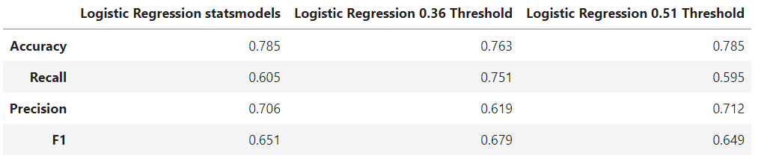
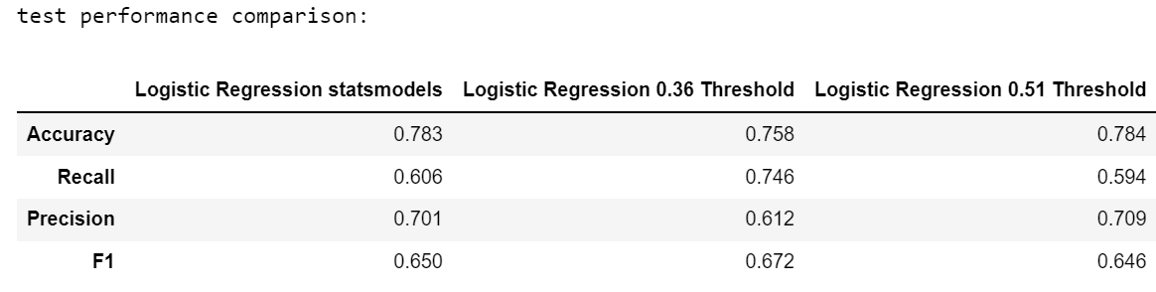
Final Model Performance Summary {test & train set}
All the logistic regression models have given a generalized performance on the training and test set.
Recall score shows the best result on logistic regression 0.36 threshold (0.74)

Slide 26
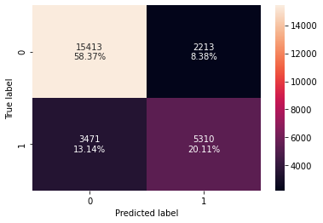
Confusion Matrix {Train set}
True Positives (TP): we correctly predicted that they do NOT CANCEL 58.37%
True Negatives (TN): we correctly predicted that they do CANCEL 20.11%
False Positives (FP): we incorrectly predicted that they do CANCEL (a "Type I error") 2213 Falsely predict positive Type I error (8.38%)
False Negatives (FN): we incorrectly predicted that they don't CANCEL (a "Type II error") 3471 Falsely predict negative Type II error(13.14%)

Slide 27
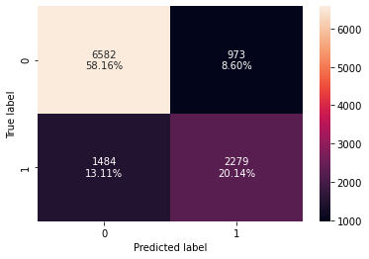
Confusion Matrix {Test set}
True Positives (TP): we correctly predicted that they do NOT CANCEL 58.16%
True Negatives (TN): we correctly predicted that they do CANCEL 20.14%
False Positives (FP): we incorrectly predicted that they do CANCEL (a "Type I error") 937 Falsely predict positive Type I error (8.60%)
False Negatives (FN): we incorrectly predicted that they don't CANCEL (a "Type II error") 1484 Falsely predict negative Type II error(13.11%)

Slide 28
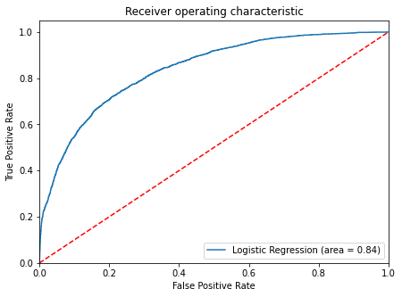
ROC curve on test set
Logistic Regression model is giving a good performance on TEST set.

Slide 29
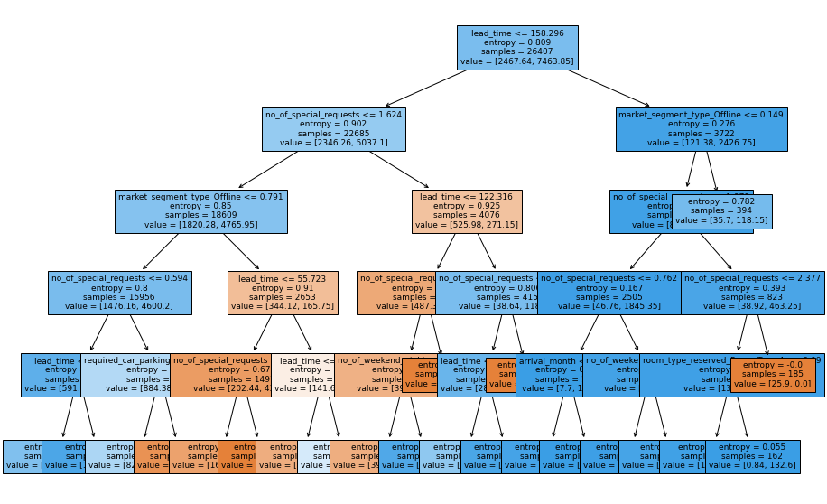
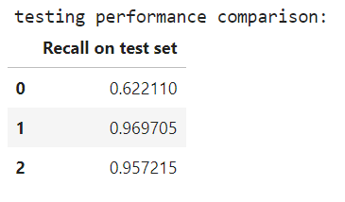
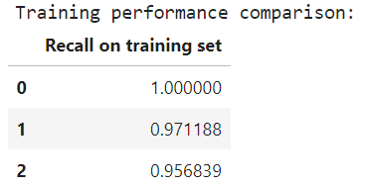
BEST DECISION TREE
Decision tree model with pre-pruning has given the best recall score on training data.

Slide 30
Business Insights and Recommendations
a) If a guest booking a room with lead_time less than or equal to 158.30 there's a very high chance the guest will not cancel his or her reservation.
b) If a guest booking a room with lead_time less than or equal to 158.30 and no_of_special_requests is less than or equal to 1.62 then there is a very high chance that the guest will not cancel his or her reservation.
c)If a guest booking a room with lead_time less than or equal to 158.30 and no_of_special_requests is less than or equal to 1.62 and market_segment_type_Offline is less than or equal 0.79 then there is a very high chance that the guest will not cancel his or her reservation.
July and August saw the highest number of bookings but also the highest number of cancellations. This should be investigated further by the hotel
It is observed that the less lead time in the reservation, a smaller number of special requests, and fewer children lead to not cancelation guests booking. By present a good deal or service to people who have a high number of children or have a high special request it may lead to getting a lower chance of canceling between them.
It is observed that repeating guests, who stay in the hotel often will cancel their booking with a very small percentage (near to zero). so, I think a loyalty program that offers - special discounts, access to services in hotels, etc for these customers can help in improving their experience.

Slide 31
Business Insights and Recommendations
The online market segment with 82% is on the top of Market segment designation. I believe that managers should invest more in this segment.
offering a good deal for new guests for second booking can help the hotel to get a high number of repeat guests.

